Slide 1
KINSHIP VERIFICATION FROM FACE IMAGES
USING
IMAGE PROCESSING TECHNIQUES

Slide 2
By
Name Roll No. PRIYANKO SARKAR 46
SATYAKI PARIA 40
Under the guidance of
Dr. NILANJANA KARMAKAR
and
Dr. ARINDAM BISWAS
Department of Information Technology

Slide 3
Analysis
Explanation of topic
Evaluation of defending objective
Scheduling , time reference and program
Team work
Personal work
Involvement in artefacts preparation

Slide 4
Explanation of topic
Problem definition:
Kinship verification is defined as the verification of the existence of genetic relationship (children – biological parent relation) between two persons by analyzing their face images using digital image processing techniques.
Objectives:
Given two human face images of a standard dimension our objective is to
extract facial features and familial traits from the images
represent them as geometric structures
Compare the geometric structures using bio-informatics methods.

Slide 5
Evaluation of defending objective
Face features like nose , eyes and mouth containing image portion from images are extracted.
Objects are extracted from images containing eyes , nose and mouth.
Objects are pre processed for better assessment.
Pre processed object is represented in geometric form.
Similarity between two respective objects(nose , eyes and mouth) of two different persons’ images are determined by bioinformatics methods.
Based on the similarities kinship is determined.
We are in the process of finding extent of similarity between the images of parent and child.

Slide 6
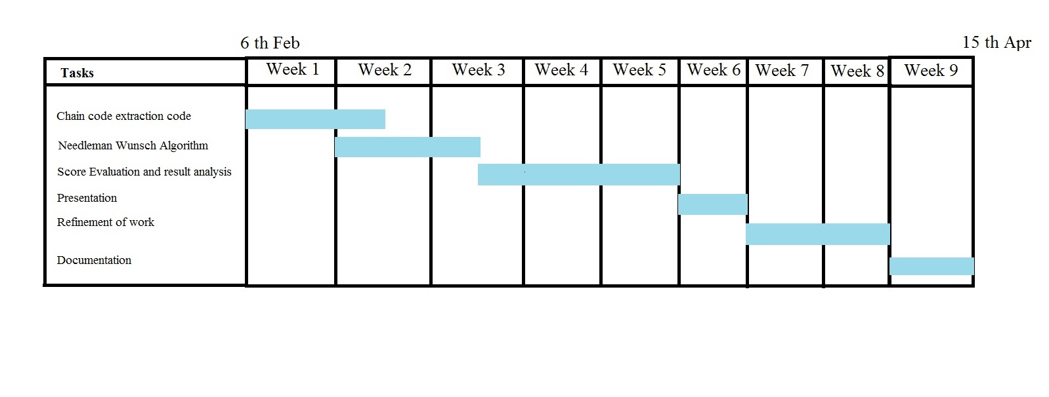
Scheduling , time reference and program
*
‘*’ represents the current position of our work.

Slide 7
Team work
Face feature extraction code
Uniform LBP Identification code
Object extraction code
Pre-processing code
Chain code extraction code
Needleman Wunsch alignment code
Presentation
Project Documentation

Slide 8
Personal work
Group members’ name | Personal work
Priyanko Sarkar | Uniform LBP Identification code Chain code extraction code Pre-processing code Presentation (Part) Project Documentation (Part)
Satyaki Paria | Face feature extraction code Object extraction code Needleman Wunsch alignment code Presentation (Part) Project Documentation (Part)

Slide 9
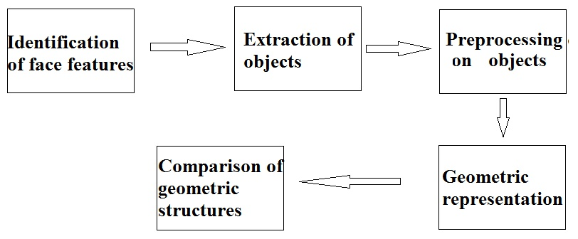
Involvement in artefacts preparation
Schematic representation of kinship verification:

Slide 10
Preliminaries
Local Binary Pattern (LBP)
Chain code
Polygon
Needleman Wunsch algorithm

Slide 11
Local Binary Pattern (LBP)
    The LBP operator was originally designed for texture description.
    The operator assigns a label to every pixel of an image by comparing the values in the 3*3-neighborhood of each pixel with the center pixel value and considering the result as a binary number.

Slide 12
Local Binary Pattern (LBP)
    An image of m*n size is padded with zero at its surrounding to turn it into an image of (m+2)*(n+2) size.
    Now starting from top left corner of the image we are running the LBP operator throughout the image.
    If neighboring pixel value <= (center pixel value + threshold value), then 1 is assigned in LBP binary pattern, otherwise 0 is assigned.
    By this an output image is created including the desired features. Based on the similarity on these features kinship measure can be done.

Slide 13
Local Binary Pattern (LBP)
150 | 200 | 4
128 | 120 | 185
164 | 32 | 16
1 | 1 | 0
1 | 0 | 1
1 | 0 | 0
11010011
LBP Binary Pattern
If neighboring pixel value <= center pixel value , then 1 is assigned in LBP binary pattern, otherwise 0 is assigned.

Slide 14
Local Binary Pattern (LBP)
150 | 200 | 4
128 | 120 | 185
164 | 32 | 16
1 | 1 | 0
1 | 0 | 1
1 | 0 | 0
1 | 2 | 4
128 | 0 | 8
64 | 32 | 16
11010011
(LBP Binary Pattern)
150 | 200 | 4
128 | 203 | 185
164 | 32 | 16
LBP Weight Matrix
Central pixel value updated
(1*1)+(1*2)+(0*4)+(1*8)+(0*16)+(0*32)+(1*64)+(1*128)=203

Slide 15
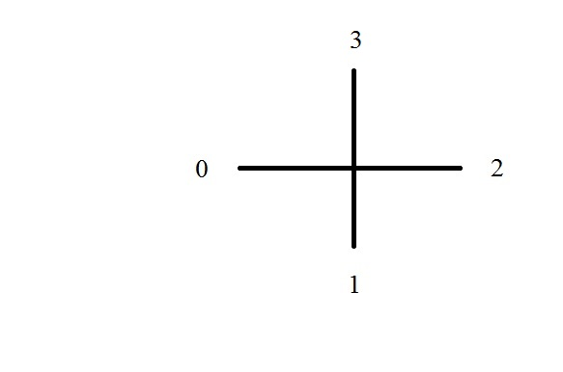
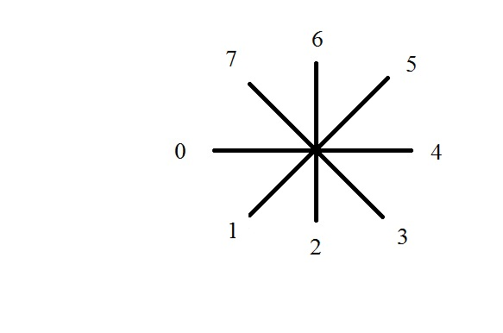
Chain code
Chain code is a series of digits which represent the boundary and shape of polygon.
Chain code are of two types:-
i) Using 4 neighbourhood ii)Using 8 neighbourhood
Lower number indicates higher priority in chain code.

Slide 16
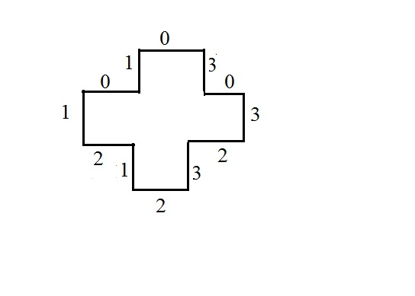
Chain code
Polygon representation by chain code :
Polygon: A 2 -dimensional shape formed with straight lines.
Polygon
4 neighbourhood chain code
4 neighbourhood chain code : 121232303010

Slide 17
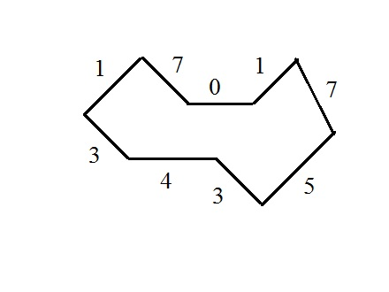
Chain code
Polygon representation by chain code :
Polygon
8 neighbourhood chain code
8 neighbourhood chain code : 343571071

Slide 18
Needleman Wunsch Algorithm
A global alignment algorithm based on dynamic programming.
Used in bioinformatics to alignment two different protein sequences.
Score is calculated based on pre-defined match score ,mismatch score and gap penalty.
Based on score it can be determined how much similarity between two sequences exist.

Slide 19
Method
Identification of face features
Extraction of objects
Preprocessing on objects
Geometric representation of the objects
Comparison of the geometric structures representing face features

Slide 20

Identification of face features
Demonstration:
22 * 64
17 * 64
15 * 64
Face feature extraction of father’s face image

Slide 21
Identification of face features
The length and width of the portions of the image containing eyes, nose ,mouth are approximately measured.
Measurement of different facial portions are done by measuring the total number of rows and columns.
On that basis portion of image containing eyes, nose, mouth are extracted.
22 * 64
17 * 64
15 * 64

Slide 22

Identification of face features
22 * 64
17 * 64
15 * 64
Face feature extraction of son’s face image

Slide 23
Identification of face features
Measurement table:
Image | Left eye (Height * Width) | Right eye (Height * Width) | Nose (Height * Width) | Mouth (Height * Width)
Father | 11 * 30 | 11 * 32 | 17 * 64 | 15 * 64
Son | 11 * 30 | 11 * 32 | 17 * 64 | 15 * 64

Slide 24
Extraction of objects
Object extraction of father’s image containing eye , nose and mouth

Slide 25
Extraction of objects
After taking out the portions we are performing Local Binary Pattern operation.
Using LBP the object can be detected with respect to the background.
Pixel intensity values of the object are higher than that of the background.
Intensity values nearer to each other are considered as the portion of the object.
By setting up different threshold values , object is detected.

Slide 26
Extraction of objects
Threshold values differ from one image to another image.
In this project after finding LBP binary pattern we determine evaluated pattern is uniform or not.
If the pattern is uniform then central pixel is exchanged with pixel intensity value 255 or 0 is assigned there.

Slide 27
Extraction of objects
Object extraction of son’s image containing eye , nose and mouth

Slide 28
Preprocessing on objects
Pre processing is required if extracted objects are disjoint.
For proper representation of an object as a polygon it is necessary for the object to be connected properly.
If black cell is surrounded by n white pixel then it’s count in count matrix will be n.
X refers to object pixel shown in count matrix.
Sample image
1 | 1 | 1 | 0
1 | X | 2 | 1
2 | 3 | X | 1
2 | X | 4 | 2
3 | X | X | 1
2 | x | 3 | 1
Count Matrix

Slide 29
Preprocessing on objects
A particular background pixel value is taken into account which is the common neighbour of threshold number of object pixels.
That particular background pixel is included in the object
Threshold 4
Pre-processed image

Slide 30
Preprocessing on objects
Pre processing of father’s image containing eye , nose and mouth

Slide 31
Preprocessing on objects
Pre processing of son’s image containing eye , nose and mouth

Slide 32
Geometric representation of the objects
Geometric representation of an object is done by extracting its chain code.
First far north-west pixel is selected.
8 neighbourhood chain code algorithm is used on it until chain code of that object is extracted.
 |  | 0 | 0 | 7
 | 1 |  |  |  | 6
 | 2 |  |  |  | 6
 |  | 3 |  |  | 6
 |  |  | 3 | 4 | 4
Shape #1
 |  | 0 | 0 | 7
 | 1 |  |  |  | 6
 | 2 |  |  |  | 6
 |  | 3 |  |  | 6
 |  |  | 3 | 4 | 4
Shape #1

Slide 33
Geometric representation of the objects
 |  | 0 | 0 | 7
 | 1 |  |  |  | 6
 | 2 |  |  |  | 6
 |  | 3 |  |  | 6
 |  |  | 3 | 4 | 4
 | 0 | 0 | 0 | 0 | 6
 | 2 |  |  |  | 6
 | 2 |  |  |  | 6
 | 2 |  |  |  | 6
 | 2 | 4 | 4 | 4 | 6
Shape #1
Shape #2
 |  | 0 | 0 | 7
 | 1 |  |  |  | 6
 | 2 |  |  |  | 6
 |  | 3 |  |  | 6
 |  |  | 3 | 4 | 4
 | 0 | 0 | 0 | 0 | 6
 | 2 |  |  |  | 6
 | 2 |  |  |  | 6
 | 2 |  |  |  | 6
 | 2 | 4 | 4 | 4 | 4
chain code : 233446667001
chain code : 2222444466660000

Slide 34
Comparison of the geometric structures representing face features
 |  | 0 | 0 | 7
 | 1 |  |  |  | 6
 | 2 |  |  |  | 6
 |  | 3 |  |  | 6
 |  |  | 3 | 4 | 4
Comparison of geometric structures are done by comparing their chain code.
To compare chain codes, chain codes are used to create global alignment .
Here taken chain code are
sequence 1 : 233446667001
sequence 2 : 2222444466660000
Needleman Wunsch algorithm is used to create global alignment.
chain code : 233446667001
 | 0 | 0 | 0 | 0 | 6
 | 2 |  |  |  | 6
 | 2 |  |  |  | 6
 | 2 |  |  |  | 6
 | 2 | 4 | 4 | 4 | 4
chain code : 2222444466660000

Slide 35
Comparison of the geometric structures representing face features
Assuming match score =5 , mismatch score =-1 and gap penalty =-2
scoring matrix is:
Shape #2 : 2 2 2 2 4 4 4 4 6 6 6 6 0 0 0 0
0 | -2 | -4 | -6 | -8 | -10 | -12 | -14 | -16 | -18 | -20 | -22 | -24 | -26 | -28 | -30 | -32
-2 | 5 | 3 | 1 | -1 | -3 | -5 | -7 | -9 | -11 | -13 | -15 | -17 | -19 | -21 | -23 | -25
-4 | 3 | 4 | 2 | 0 | -2 | -4 | -6 | -8 | -10 | -12 | -14 | -16 | -18 | -20 | -22 | -24
-6 | 1 | 2 | 3 | 1 | -1 | -3 | -5 | -7 | -9 | -11 | -13 | -15 | -17 | -19 | -21 | -23
-8 | -1 | 0 | 1 | 2 | 6 | 4 | 2 | 0 | -2 | -4 | -6 | -8 | -10 | -12 | -14 | -16
-10 | -3 | -2 | -1 | 0 | 7 | 11 | 9 | 7 | 5 | 3 | 1 | -1 | -3 | -5 | -7 | -9
-12 | -5 | -4 | -3 | -2 | 5 | 9 | 10 | 8 | 12 | 10 | 8 | 6 | 4 | 2 | 0 | -2
-14 | -7 | -6 | -5 | -4 | 3 | 7 | 8 | 9 | 13 | 17 | 15 | 13 | 11 | 9 | 7 | 5
-16 | -9 | -8 | -7 | -6 | 1 | 5 | 6 | 7 | 14 | 18 | 22 | 20 | 18 | 16 | 14 | 12
-18 | -11 | -10 | -9 | -8 | -1 | 3 | 4 | 5 | 12 | 16 | 20 | 21 | 19 | 17 | 15 | 13
-20 | -13 | -12 | -11 | -10 | -3 | 1 | 2 | 3 | 10 | 14 | 18 | 19 | 26 | 24 | 22 | 20
-22 | -15 | -14 | -13 | -12 | -5 | -1 | 0 | 1 | 8 | 12 | 16 | 17 | 24 | 31 | 29 | 27
-24 | -17 | -16 | -15 | -14 | -7 | -3 | -2 | -1 | 6 | 10 | 14 | 15 | 22 | 29 | 30 | 28
2
3
Shape #1:
3
4
4
6
6
6
7
0
0
1

Slide 36
Comparison of the geometric structures representing face features
Alignment is done based on trace back on scoring matrix.
Alignment based on given match score, mismatch score and gap penalty is :
Shape #1: _ _ _ 2 3 3 4 4 _ 6 6 6 7 0 0 1
Shape #2: 2 2 2 2 4 4 4 4 6 6 6 6 0 0 0 0
Here Score is based on 8 matches, 4 mismatches and 3 gap penalty.
Score = (8 * 5) + (4 * -1) + (3 * -2) = 28.

Slide 37
Experimental Result
Identification of face features
Extraction of objects
Preprocessing on objects
Geometric representation of the objects
Comparison of the geometric structures representing face features

Slide 38
Identification of face features
Extraction
Chain code for father’s left eye : 2 2 2 1 3 5 6 5 3 3 4 4 4 5 4 4 6 6 6 0 0 0 0 0 0 0 0 0 0
Chain code for son’s left eye : 2 3 3 5 4 4 5 3 4 3 4 5 4 5 4 3 6 7 5 7 7 0 0 0 0 0 0 1 0 0 0 3 1 0 0 0
Pre processing

Slide 39
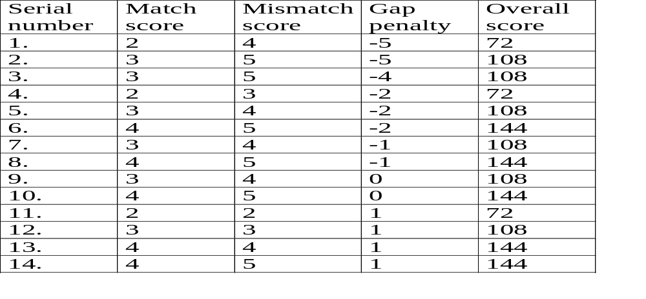
Comparison of the geometric structures representing face features
Needleman Wuncsh algorithm is applied on chain codes of father’s left eye and son’s left eye.
For various different match score, mismatch score and gap penalty , overall score is:

Slide 40
Application
Motivation for doing this project involves its use in real world for
A) Finding missing children.
B) Helping in adoption of children.
C) Stopping trafficking/smuggling of children.

Slide 41
Assumption
Some assumption are taken under consideration which include
1) All images should be of equal height and width.
2) All images should be taken in standard lighting condition (brightness) and with standard equipment.
3) All images should be taken by keeping the model persons in same standard posture.
4) All images should be taken avoiding any sudden flash of light in image or blurriness.
5) For every image ratio of background data (ear, eyebrows, backdrops, Neck, Jaw, Forehead, Head & its hair) & facial/familial feature based data should be same.
6) Contrast and histogram of both images should be equal or nearly equal.

Slide 42
Future scope
Project should be able to use images with different facial expression , multiple postures and age differences.
Histogram equalization and histogram specification will be used on images so we can take into account the illumination of original images.
Refine the process of extraction of facial features using intensity profile and scan line approach.

Slide 43
We are thankful for the cooperation we get from our mentor and other teachers.
Thanking you
Priyanko Sarkar (46)
Satyaki Paria (40)

